Slide 1
Spam mail detection

Slide 2
contents
Abstract
Introduction
Dataset
Exploratory data analysis
Models
Results evaluation
conclusion

Slide 3
abstract
As the digital communications are getting increased , spam mails are growing in the same way which is affecting the security and user experience as well.
This project aims in Development of the spam detection systems using the machine learning models to classify the messages as SPAM or HAM(Non-Spam).
Implementation of three machine learning models—Multinomial Naive Bayes, Logistic Regression, and SVM to process and classify the text.
High accuracy and effectiveness in spam detection, with SVM showing the best performance compared to other models.
The findings suggest that machine learning is a potent tool for enhancing communication security and efficiency.

Slide 4
Introduction
As we all are aware of the fact that spam messages can potentially lead to security risks and productivity losses.
So there is a need for the effective modelling system which make sures the security and also ensures the integrity during the digital communications.
Use of advanced machine learning models and preprocessing techniques to handle the unique challenges of text data in spam detection.

Slide 5
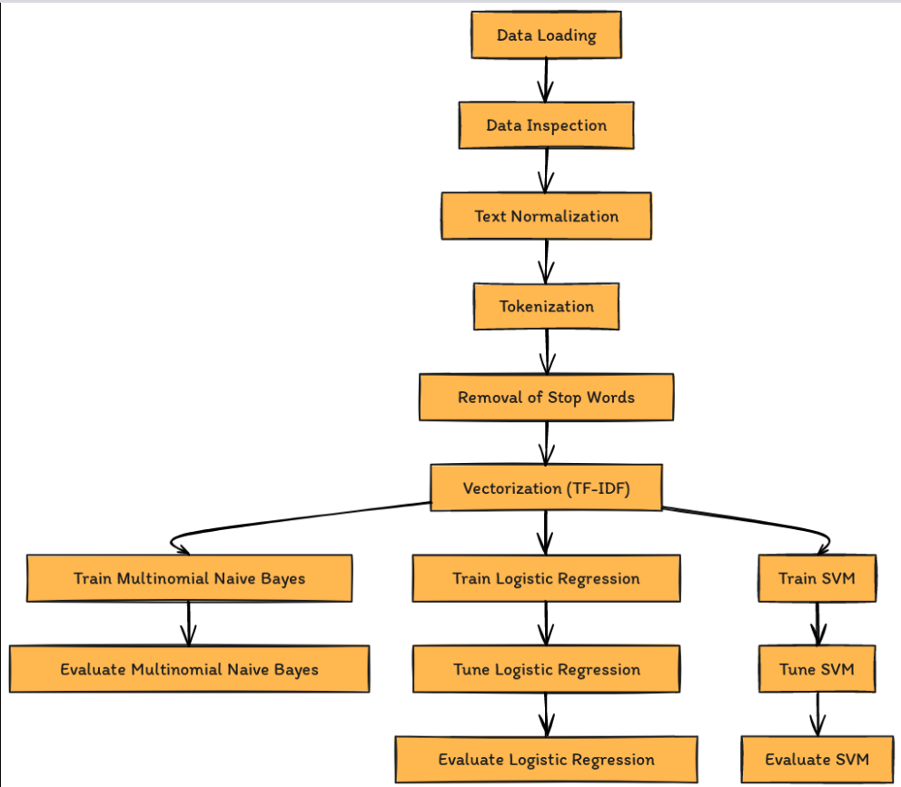
WORK-FLOW
Data Preprocessing:
Model Implementation:
Evaluation and Comparison

Slide 6
Dataset
The dataset has 5,572 SMS messages, labeled as either spam or ham, used to train and test the machine learning models.
The features of the dataset are two: which includes the category(Spam/Ham) and the message content(Text).
Data preprocessing is performed on the data before feeding it to the models.

Slide 7
Data preprocessing
In this phase as we all know preprocessing of dataset is the primary step in any project, where it make sures the model is getting trained on efficient dataset.
Usually the preprocessing involves the checking for null and duplicate values and removing them
Normalization is done on the dataset, which converts all the text to lower case.
Tokenization is done , which is responsible in Splitting text into words and then removal of stop words subsequently.
Vectorization is being done on the dataset, using the TF-IDF to transform text into a format suitable for model training.

Slide 8
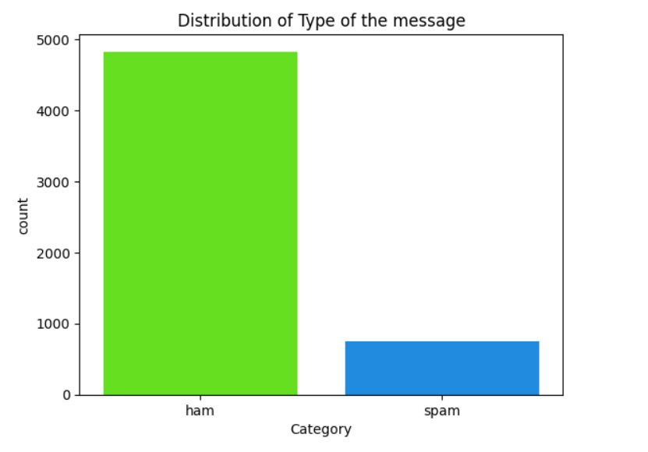
Exploratory data analysis
EDA reveals patterns and trends that inform model selection and training
Bar chart showing the imbalance between ham and spam messages in the dataset.

Slide 9
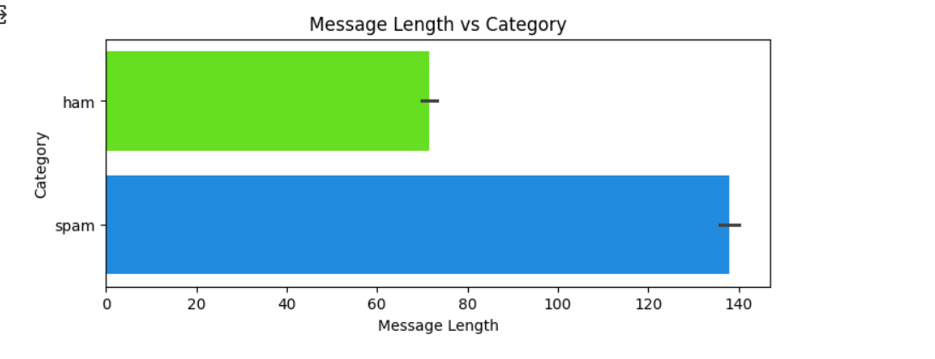
Exploratory data analysis
Graph displaying differences in the average length of spam and ham messages, highlighting that spam messages tend to be longer.

Slide 10
MODELS
Multinomial Naive Bayes :
Described as a probabilistic model ideal for discrete feature classification, commonly used for its efficiency in text classification tasks.
The model was trained using the multinomialnb() class from sklearn.naive_bayes.
Logistic Regression:
Explained as a model that estimates probabilities using a logistic function, which is well-suited for binary classification tasks.
We have used the logisticregression() class from sklearn.linear_model, with the model trained on the training data.
Support Vector Machine (SVM):
Introduced as a powerful classifier that uses kernel functions to handle linear and non-linear data, offering high accuracy in high-dimensional spaces.

Slide 11
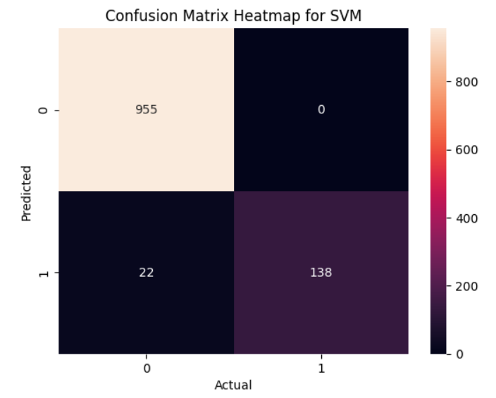
RESULTS EVALUATION
As from the performance metrics we can state that SVM model has the highest overall performance among the three models which we have chose to implement. which achieved nearly 98% of the accuracy on the test set, which showcases the great balance between the recall and precision, in particularly for the spam detection.

Slide 12
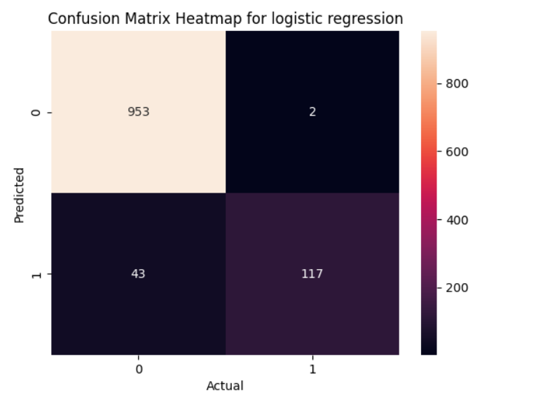
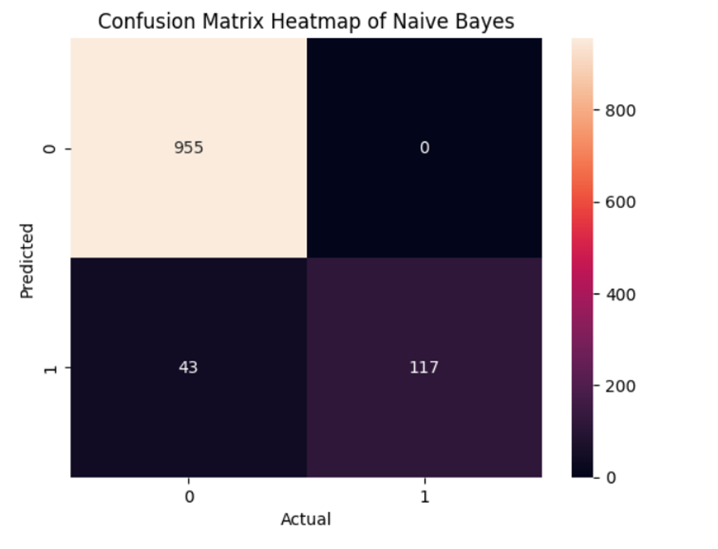
Results evaluation

Slide 13
CONCLUSION
SVM is identified as the most effective model for spam detection in this project, given its high precision and recall rates.
Enhanced spam detection capabilities can significantly improve security and user experience in digital communications.
Potential for future improvements includes exploring deep learning models, real-time spam detection, and expanding the model to multilingual text analysis.

